Slide 1
2- Industry General Characteristics

Slide 2
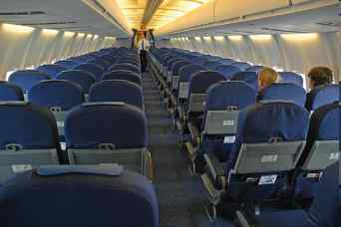
A perishable product: any unsold seat is lost...
… which explains some “price wars” when crisis and overcapacity.

Slide 3


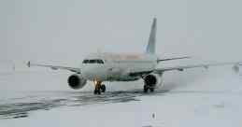

An activity highly sensitive to geopolitical and geophysical events
“Arab Spring” 2011
Eyjafjallajôkull 2010
Snow Tempest on US East Coast
October 2011
H1N1 Virus 2009
Within 2 years !!!!

Slide 4
A fragmented industry, capital-intensive ...
New aircraft deliveries in the next 20 years
Large
Regional
30 900 deliveries by 2029, for an estimated total value of $ 3 590 billions
(based on catalog price, source Current Market Outlook 2010-29 Boeing)
Twin aisle
Single aisle
60% of 2010 China GNP
140% of 2010 France GNP
Airbus A320 $ 80 millions
Airbus A380 $ 350 millions
Source: Magazine du tourisme 2011

Slide 5
... and labour-intensive as well.
Weight of staff costs in total costs in 2008
Air Transport
Telecom
Automobile
Supermarkets

Slide 6
An Industry with a strong growth for the past periods…
Over the past 30 years, the airline industry has shown continuous growth of around 5% per year
RPK (millions)
30-year CAGR: +4.8%
Sources : ICAO, IATA, Boeing CMO, Airbus GMF, Embraer Market Outlook, RRoyce Market Outlook

Slide 7



… which may rely on a structural trend of growth of 4 to 5% per year supported by the globalization of economy.
2010-2029 Yearly RPK growth
+4.8%
+4.9%
+5.0%
+5.3%
5% !

Slide 8
Strong growth, beyond the current economic woes, but…
The forcasted growth seems very positive for the industry but,
- the market is cyclical because of the challenging economic basis,
- the profitabilty during the past 20 years was very low and “volatil”,
- the position of the airlines in the chain value is not favourable,
- long-term trend: decreasing unit revenue.
- very high and growing sensibility on price.

Slide 9
A A SUCCESSION OF MAJOR CRISIS FOR 20 YEARS
16%
1970 - 1980
1980 - 1990
1990 - 2000
When crisis , traffic drops much more then economy …
14%
12%
+ 9,4%
…when economy grows
traffic grows twice faster…
10%
- - - - - - - - -
+ 6,9%
+ 6,5%
8%
6%
+ 4,0%
+ 3,7%
4%
+ 3,1%
2%
0%
1970
1971
1972
1973
1974
1975
1976
1977
1978
1979
1980
1981
1982
1983
1984
1985
1986
1987
1988
1989
1990
1991
1992
1993
1994
1995
1996
1997
1998
1999
2000
2001
2002
-2%
Gulf crisis
Economic recession
-4%
Gulf war
11September
SARS
Yearly world traffic growth
Yearly world GDP growth
Yearly world GNP growth
Sources : OACI, FMI

Slide 10
Air Transport: cycles and low profitability…
Industry Net profits (Billions $)
EBIT margin
Right scale
Gulf crisis
economic recession
September 11
Credit crunch
Recession
Fuel hedging losses
From1991 to 2010 the industry lost more than 10 billions $ and 35 millions $ from 2001 to 2010
SARS
Irak War
Extra oil price
Japanese tsunami
Middle-East and
North-Africa Troubles
Net postaxes losses
Left Scale
Source: IATA Financial forecast Sept 2011

Slide 11
Airlines remain the weakest position on air transport value chain
Source : McKinsey, 1998
16%
Cost of capital :
8 to 9.5%
15%
15
11-14%
10-13%
10%
10
6%
5
Aircraft
Manufacturer
Aircraft
Lessors
Handling
Catering
Airports
Airlines
From now on only 2 players
2 players control 45% of market (ILFC and GECAS)
monopoly in stations non open to competition
less than 3 players in other
First 2 players have 40%, first 7 70% of market
less than 3 players per station
often only 1 airport in a city
first 10 players have 43% of revenue
first 25 69%
first 50 84%

Slide 12
LONG-TERM TREND: DROPPING UNIT REVENUE
Recette Unitaire Internationale
(compagnies aériennes régulières, hors inflation, source ATA)
1950 - 2002
50
45
40
35
30
US cents / RPM
25
20
15
10
5
1950
1953
1956
1959
1962
1965
1968
1971
1974
1977
1980
1983
1986
1989
1992
1995
1998
2001

Slide 13
Price sensibility
GDP Elasticity = + 2
0 < Price Elasticity < -3
Δ Demand %
+ X %
0
12
Δ price %
GDP growth = 3%
➔ Demand growth = 6 %
+
6
- Y %
Δ demand%
With a too high price increase demand could drop.
Δ GDP %
0
3
6

Slide 14
3- Markets General Characteristics

Slide 15
FROM WEST TO EAST….
PRESENTLY THE MAIN FLOWS OF TRAFFIC ARE STILL:
- ORIENTED TO NORTH-AMERICA AND EUROPE,
- INTRA NORTH-AMERICA AND EUROPE AREAS,
BUT THE EMERGING MARKETS ARE CHANGING THE PICTURE
AND THE MARKET IS BALANCING FROM WEST TO EAST.

Slide 16
The dominant share of traffic flows today is still oriented to North America and Europe
Share of main routes worldwide in 2009 (% of RPKs)
North America
Europe
9,0%
13,8%
19,9%
6,5%
4,4%
2,9%
Asia
1,0%
1,1%
Focus on China:
Europe from/to China: 1,6%
Within China: 6%
0,3%
2,5%
14,7%
Asia
3,8%
3,1%
Middle East
0,6%
2,2%
0,7%
3,6%
0,8%
Africa
3%
Latin America
1,7%
Pacific
Pacific
>10%
5-10%
2-5%
Intra-regional
shares
<2%
Source: PR.DN, Boeing 2009-2029
Inter-continental%
Notes:
16

Slide 17
The strongest growth is likely to be in emerging markets, both on intercontinental and intra-area routes
CAGR Traffic growth (RPK) 2009-2029
North America
Europe
4,3%
405⇨946
4,1%
625⇨1409
2,8%
898⇨1566
5,6%
292⇨875
4,5%
199⇨483
7,2%
44⇨177
6,0%
133⇨427
Asia
6,0%
49⇨157
7,4%
663⇨2765
Focus on China:
Europe from/to China: +6,0%
Within China: +7,9%
7,3%
12⇨48
7,3%
113⇨468
Asia
5,3%
173⇨484
4,6%
138⇨340
Middle East
6,5%
27⇨95
4,9%
30⇨79
4,6%
164⇨399
5,7%
36⇨109
6,0%
100⇨323
Africa
7,1%
135⇨536
Pacific
5,3%
75⇨212
Latin America
Pacific
>7%
Global CAGR Traffic growth: + 5,3%
Long haul CAGR Traffic growth: + 5,4%
Europe (within and to/from) CAGR Traffic growth: +4.7%
5-7%
Intra-regional
<5%
Inter-continental%
xx%
yy⇨zz
+xx% p.a. growth
From xx B RPKs in'09 to yy in'29
Source: PR.DN, Boeing 2009-2029
Notes:
Focus on China:
Europe to and from China: +6,0%
Within China: +7,9%

Slide 18
Growth in Asia will progressively tilt balance to the East
Share of main routes worldwide in 2029 (% of RPKs)
North America
Europe
7,5%
(-1,5 pts)
11,2%
(-2,6 pts)
6,9%
(0,5 pts)
3,8%
(-0,6 pts)
12,4%
(-7,4pts)
Asia
1,4%
(0,4 pts)
3,4%
(0,5 pts)
Focus on China:
Europe from/to China: 1,9% (0,3 pts)
Within China: 9,9% (3,8 pts)
1,2%
(0,2 pts)
21,9%
(7,3 pts)
Asia
0,4%
(0,1 pts)
2,7%
(-0,4 pts)
3,7%
(1,2 pts)
3,8%
(-)
Middle East
0,8%
(0,2 pts)
2,6%
(0,3 pts)
0,6%
(-)
3,2%
(-0,4 pts)
0,9%
(0,1 pts)
Africa
4,3%
(1,3 pts)
Pacific
Latin America
1,7%
(-)
Pacific
>10%
5-10%
2-5%
Intra-regional
share
<2%
xx%
(+yy pts)
xx% share of WW RPKs
Share increasing by +yy pts from '09 to '29
Source: PR.DN, Boeing 2009-2029
Inter-continental%
Notes:
18
Focus on China:
Europe to and from China: 1,9% (+0,3 pts pts)
Within China: 9,9% (+3,8 pts)

Slide 19
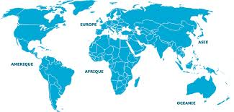
But more than 50% of traffic flows will still remain intra-areas traffics.
20%
14%
12%
11%
1%
15%
1%
1%
22%
3%
1%
2%
4%
2%
2009 WW traffic flows
Intra-areas 56%
2029 WW traffic flows
Intra-areas 53%

Slide 20
4- LES DEFIS…

Slide 21
4- 1. Air Traffic Congestion

Slide 22
Routes, Lanes and slots are limited while traffic is booming
- Sharing air space between Military and Civil traffic.
- Lanes congestionned in many areas.
- No more slots in peak hours on many main airports.
- Hub system concentrate traffic around few banks
- Terminals, bags systems, Controls.
Slow facilities development Booming traffic
Global Air Traffic Control centers
More runways on main airports.
International/Domestic Airports.
Developing secundary airports.
Bigger aircrafts. (1 A380 = 2 B777)
Early/late/night flights on peak periods.
HSP* feeding for Hubs.
Problems
Delays
Misconnections
Lost bags
Bad attendance
Over costs
Answers
* High Speed Train

Slide 23
4-2. TGV SUR COURTE DISTANCE

Slide 24
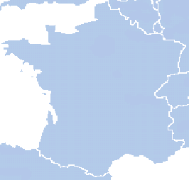
Le TGV : une baisse inéluctable des parts de marché de l’aérien sur le domestique. Exemple de la France.
La France à moins de 3h30 de Paris***
1980
2010
2020
LIL
LIL
LIL
SXB
BES
SXB
BES
PARIS
SXB
PARIS
RNS
PARIS
RNS
BES
RNS
NTE
NTE
NTE
GVA
GVA
GVA
BOD
LYS
BOD
LYS
BOD
LYS
TLS
TLS
TLS
BIQ
MRS
NCE
BIQ
MPL
NCE
BIQ
MRS
NCE
MRS
Aujourd’hui, plus de 70 % de la population française est à moins de 3h30 de Paris en train … en 2020, ce sera 90%
*** Market share: 50% TGV / 50% Airplane

Slide 25
TGV: UNE CONCURRENCE “TERRIBLE” POUR LE COURT COURRIER
La “loi” de la concurrence Train/Avion
100%
80%
60%
Part de marché du TGV en %
Avantage TGV
Avantage Avion
40%
20%
2 h
4h
6 h
Durée du trajet en TGV

Slide 26



High-speed train continues to expand
French domestic market is dominated by the high-speed train
The high-speed train service continues to develop in Europe and in other parts of the world and is capturing market share from the air transport sector
Domestic traffic
Spain: AVE launched Madrid Valence service end-2010
OTHERS
  Air transport market share dropped from 57% to 26% in 3 months with the arrival of AVE
  Facing this pressure, Iberia has decreased its capacity by -57% during summer 2011, Spanair by -46% and Ryanair has closed the route
4%
15%
81%
China:
Wuhan-Guangzhou: 1,000 km in 3h
On journeys of less than 1,100km, high-speed train catches 40% of air passengers
Sources: SNCF, Air France, DGAC – 2009
Notes:
Domination by the TGV on the French domestic market should increase with expected developments in the years to come. With a network of 1,900 kms, high-speed lines should cover 2,000 kms more by 2020 (including the extension to Bordeaux, Toulouse and Spain’s LGV) and an additional 2,500 kms beyond. But this ambitious target set by the Grenelle Environment is not without risk for the SNCF. Over large distances (trips over more than 4 hours by TGV), the question of the train’s performance compared with aircraft has to be asked. In addition, higher infrastructure tolls paid to RFF (Reseau Ferré de France) weighs heavily on the SNCF’s costs and could exacerbate the imbalance of its accounts. Added to this are the difficulties of financing. While the finance plan for the single Tours-Bordeaux segment has not even been finalized, LGV future investment, which is unprofitable, is a bottomless pit for public finances.
The high-speed rail link continues to expand both in Europe and the rest of the world. China has the fastest developing and the fastest high-speed train link. Chinese airlines are faced with a new form of competition. After the launch of the Wuhan-Guangzhou route (3 hours), capacity was greatly reduced within a radius of 600kms around Wuhan. The launch of the non-stop Beijing-Shanghai route in 5 hours scheduled for June 2011 may also have a strong impact on current capacity (between 30 and 40 flights a day), speeding up Chineses airlines transfer of capacity on international routes.

Slide 27
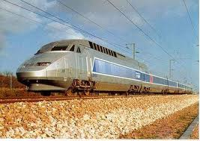

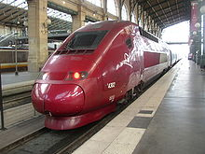

LE TGV: ADVERSAIRE MAIS AUSSI PARTENAIRE.
LA DESSERTE D’UN HUB PAR LE TGV EST UN ATOUT IMPORTANT:
- “UN AVION SUR RAIL”
- LE TGV EST UN FEEDER REGULIER ET DE QUALITE.
- UN PRODUIT COMBINE TRAIN + AVION “TGVAir”
- LE TGV LIBERE DES SLOTS POUR LE MC ET LE LC.
20 destinations domestiques TGVAir
BRU-CDG 5 liaisons quotidiennes
1 h 20

Slide 28
4-3. LOW-COST ON MEDIUM HAUL

Slide 29
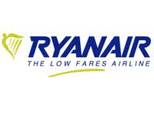














LOW COST: a generalized concept
Low Cost players are spreading in all countries and all industries….
…. in air transport as well !!!

Slide 30
LOW COST CARRIER “REVOLUTION”.
ANTICIPATING A LOT BEFORE TRADITIONAL AIRLINES AIR
MARKET CHANGES….
- DEREGULATION
- RAPID SPREADING OF E-DEVICES AND E- PROCESSES.
- EVOLUTION IN DEMOGRAPHY, BEHAVIOUR, SOCIETY.
LOW COST CARRIERS HAVE REVOLUTIONIZED AIR TRANSPORT
AND DISRUPTED FORMER SITUATIONS.

Slide 31
THE KEY OF THE SUCCESS: AS SIMPLE AS POSSIBLE
- Optimized fleet (only one aircraft model)
- Point to point flights (no connections)
- Middle size Cities to European Capitals (with grants)
- Simple pricing: “the earlier you book, the cheaper you pay”. No refund.
- Direct distribution via Internet and Credit Card
- Only Electronic ticketing.
- Mostly secundary airports or specific “low-cost” terminals.
- Bare minimum for service and all extras to be paid.
- Reduced staff costs.
WE KEEP IT SIMPLE !

Slide 32
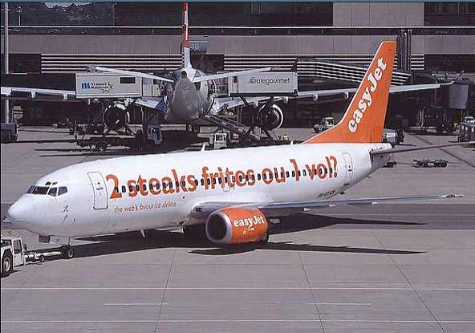
A VERY “NEW” AND AGRESSIVE COMMUNICATION ….
… WITH PRICE IN THE CENTER !

Slide 33

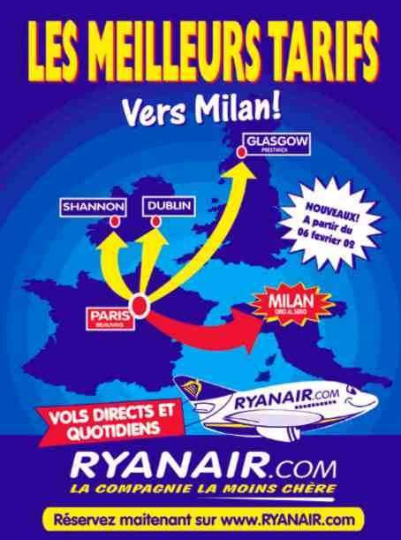

TYPE OF ADVERTISING

Slide 34




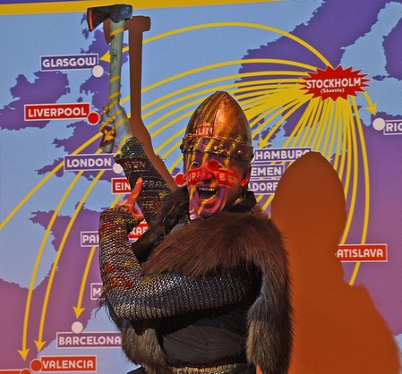
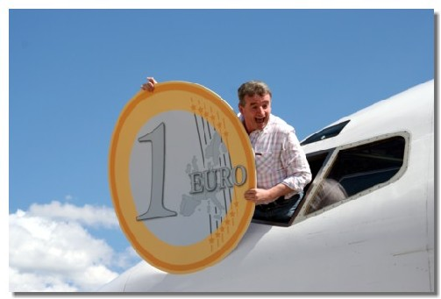

Ryanair’s C.E.O Michael O’Leary’Show

Slide 35

On european medium haul, Ryanair and Easyjet are major players…
LCC are conquering market share strongly in Europe…
Market share (seats) in 2002 and 2010
Source : OAG

Slide 36
… and overpass main network airlines.
Passenger traffic in Europe and North Africa in millions pax (estimations)

Slide 37
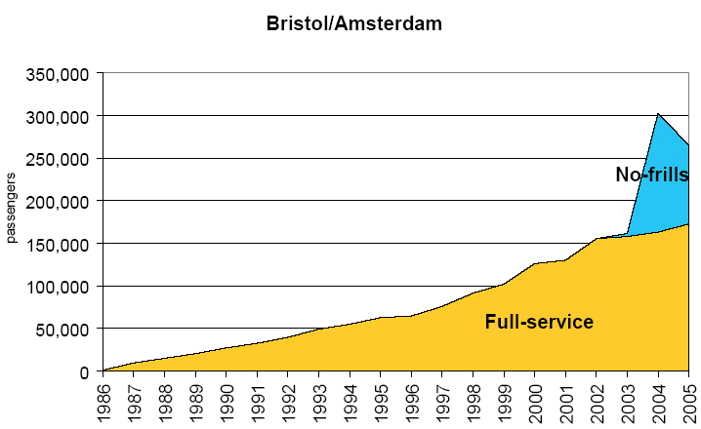
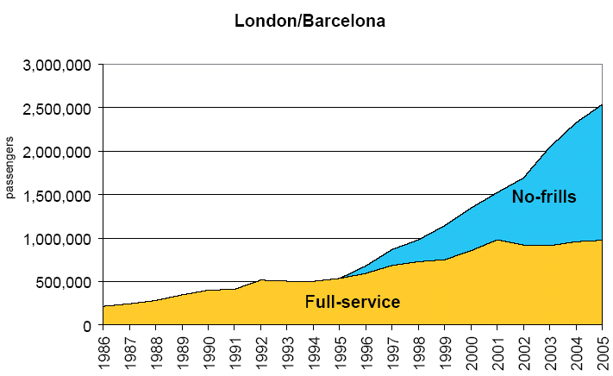
Low-Cost arrival could develop traffic a lot…
Especially secondary destinations
Or when the route was operated
by only 1 or 2 airlines.
Source : UK’s Civil Aviation Authority

Slide 38
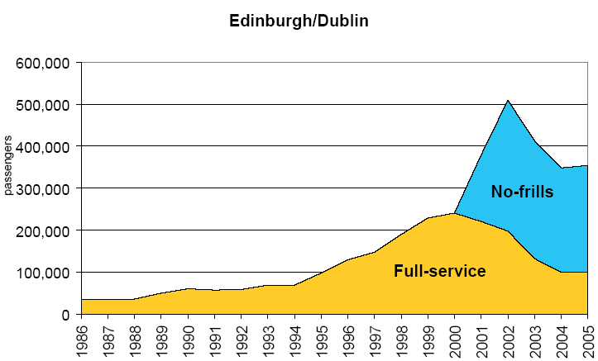
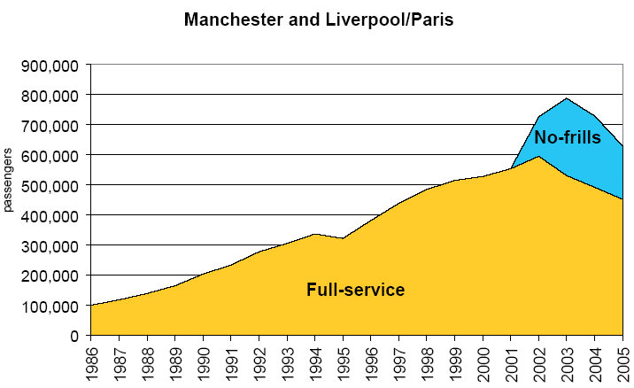
... But catch market share as well from network airlines
On main Routes
Phase 1: additional traffic
Phase 2 : growth by catching market share
Source : UK’s Civil Aviation Authority

Slide 39
With a continuous growth in all european countries…
… and a very strong position everywhere.
61%
53%
52%
48%
42%
39%
37%
37%
35%
29%
28%
27%
22%
18%
Espagne
Irlande
Pologne
Italie
Grèce
France
Suède
TOTAL
Allemagne
Portugal
Autres
Grande Bretagne
Pays-Bas
Suisse
% of Low-Cost in offered seats in intra european traffic (except domestic)

Slide 40
Low-Costs-Carriers represent now majority of European traffic
European traffic (millions pax)
Yearly average growth
2007/1996
44%
Low Costs
AEA Companies: + 3%
LCC Companies: + 31%
4%
11%
Charters
39%
45%
A.E.A Companies
57%
WITHIN 10 YEARS !!!
                Incluant une partie opérée par des Low Cost .source: AEA, eurostat

Slide 41
Cost structure benchmark Network carrier/Low cost on Medium Haul
Our cost per seat is more than twice larger than easyJet…
…which manages to achieve a much higher utilization of its assets
Stage length
1044 km
1089 km
Flights
4,8
per day
5,9
per day
+17%
- 52%
x
x
Seating
138 seats
156 seats
+13%
x
x
-52%
Others
Load
Factor
64,7%
82,4%
+18 pts
-87%
Distribution + Catering
=
=
-64 %
Maintenance + Aircraft +
insurance
430
passengers
per day
725
passengers
per day
-69 %
Crew
Passengers
+69%
+2 %
Fuel + Navigation
-52%
Handling + Airport
Comparison of A319 productivity, AF vs. U2
(aircraft with comparable stage lengths)
Charges
Sources: DWH, CAA, U2, OAG, civil year 2008
Cost per seat – Medium Haul
(NB: Euroconcept A319 are facing ‘hub’ productivity penalty)
source: ARA 2008 , EUR (All type of aircraft) excl marketing flights & Franchisees, U2 2008 annual report

Slide 42
Cost differential is split between operating model and efficiency…
Cost per seat – Medium Haul
Focus on the A319 fleet
Seat
Density
Hub
Other*
AF Europe
Model
51%
Efficiency
49%
easyJet
A319
Europe
*Other include part of distribution, Catering & Overhead

Slide 43












LCC: Services « à la carte ».
Low fares but all extras are paying ones
Exemples de prix pratiqués par EasyJet et Ryanair
Assurances
Entre 2 et 7,5€ par paiement
16€
Embarquement prioritaire entre 6 e7,5€ ou choix du siège (non dispo chez FR et U2)
Réservation
Modification (téléphone ou Internet) : entre 26 et 45€
Changement de nom : 54€ chez U2, 100€ chez FR
Entre 6 et 15€ par bagage
8 à 9€ du Kg excédentaire
Equipement sportif 60€
34c€/min pour Ryanair,
14€ par réservation pour easyJet
2€
Tarif bébé 20€
5€
1,5€
2,5€
0,5€ pour Ryanair

Slide 44
4-4. New competitors and new business models on Long Haul

Slide 45
New players are emerging with very competitive cost
- CLOSE LINKS WITH THEIR “HOME” STATE..
- GEOGRAPHICAL POSITION FAVOURABLE IN “MOVE TO EAST”
- SPECIALIZED L.H./L.H. HUBS
- OIL “AVAILABILITY”
- FINANCIAL “AVAILABILITY”.
- COMPETITION IMBALANCE
- ATTRACTIVE EXCHANGE LEVELS

Slide 46


On long-haul network, Gulf carriers act as predators without complying with the same rules and constraints as European airlines
Sharp market share increase on Europe to Africa, Asia and Middle East routes
Still sky-high ambitions
  Qatar Airways will launch 7 new destinations in Europe in 2011 and will gain access to Canada
  Etihad consolidates its destinations in Europe
  Emirates launches Geneva and Copenhagen in S11
  Turkish Airlines aims at developing a hub strategy and target a fleet of 200 aircraft in 2013
Air France - KLM
Lufthansa - Swiss
Emirates
Qatar
British Airways
Etihad
Source : DWH Midt
A disproportionate fleet growth…
:
+200 widebodies from 2011 to 2016
Long-haul fleet plan 2009-2016 Emirates-Qatar-Etihad
Source: Ascend
Notes:
State advantages, fleet financing, non-commercial benefits and lack of clarity are the cornerstones of Gulf carriers activity.
Thanks to a wide choice of connecting destinations, enviable geographical locations and supported with a strong and growing long-haul fleet, Gulf carriers gain increasing shares of traffic flows, especially from Europe to South East Asia/Australia and from Asia to Africa.
Icing on the cake, they enjoy state support distorting competition with foreign airlines such as tax regime and social benefits: exemption from social security, corporate tax and additional taxes marring European airlines activity to name a few.
In addition, their respective states are investing heavily in airport infrastructures: the new Al Maktoum airport of Dubai will open in 2012, the new one in Doha in 2015, both optimized for larger aircraft like the A380. Airport charges are also among the lowest in the world. In addition, Emirates Group is in a monopoly situation in Dubaï through dnta its airport handling company.
These states also guarantee fleet financing, Qatar Airways’ orders being carried by the state-run Qatar Investment Authority for example. Finally, to have a clear idea of Gulf carriers financial performances proves difficult as well as cross-checking their corporate announcements. Indeed, Qatar Airways and Etihad are not audited and do not publish any report.
On Europe doorstep, Turkish Airlines is following a similar strategy of intercontinental hub: +16% in international passengers and +13% of connecting passengers “international to international” in 2010. Unlike Gulf carriers, it can rely on a large domestic network and a strong presence in Eastern Europe and Central Asia. But even if its fleet has risen sharply in recent years, the company’s lack of wide bodies orders beyond 2012 and its long-haul network is still much lower than Emirates’ one.

Slide 47
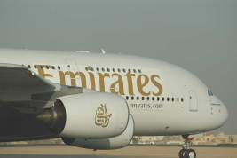
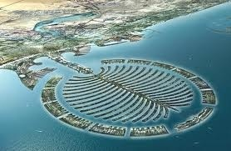

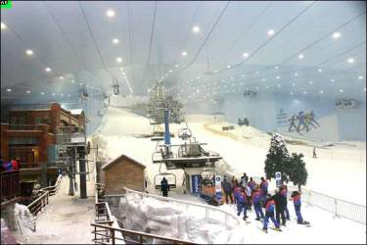
Tremendous Figures!
  180 millions passengers passing via DXB
  (120 via Djebel Ali + 60 via Dubaï International)
  Within 40 millions tourists for Dubaï…
2020 TRAFIC TO DXB
Emirates estimations.
3
2260
800
Gulf ‘s companies
Aircrafts
2010
2030
Airbus estimation : 2011 DXB air show

Slide 48
4- 5. Business Aviation and Business Airlines on High Yield

Slide 49



Business Aviation try to catch the Very High Yield customers.
All business Class companies.
Paris New-York
Paris Washington
Business Aviation
Private aircraft
Time-Sharing
Internal Companies Flights
Special events
Special services for Corporates on “niches”
Petroleum destinations, Engineering sites,…

